Slide 1

TouchIt 3D
INTERACTIVE TACTILE MAPS & MODELS
LINKABLE WITH MOBILE DEVICES
Radek Barvíř
Palacký University Olomouc

Slide 2
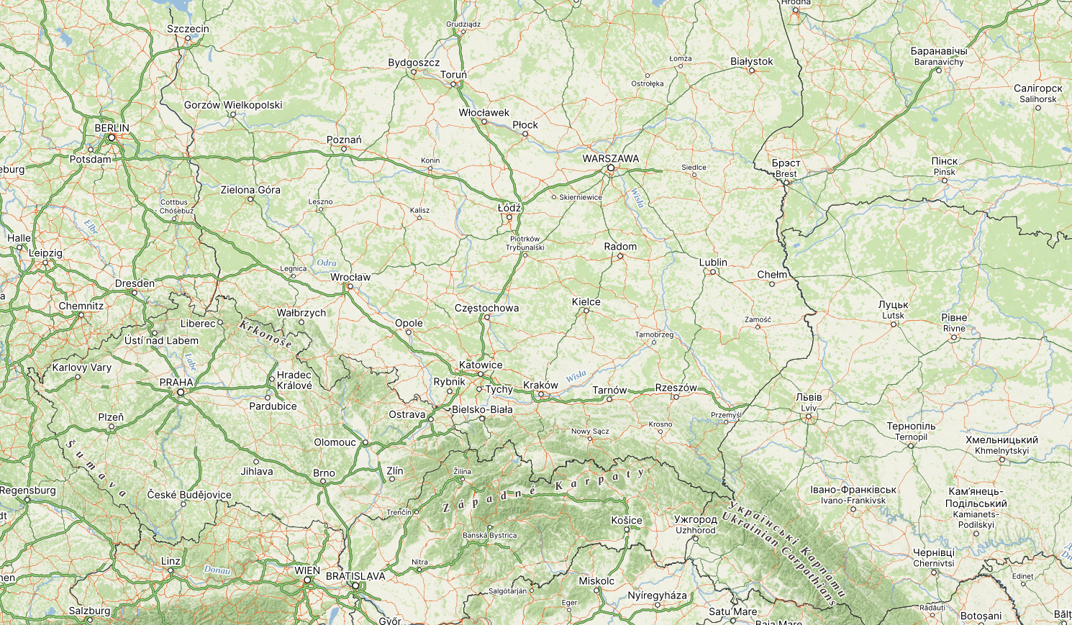
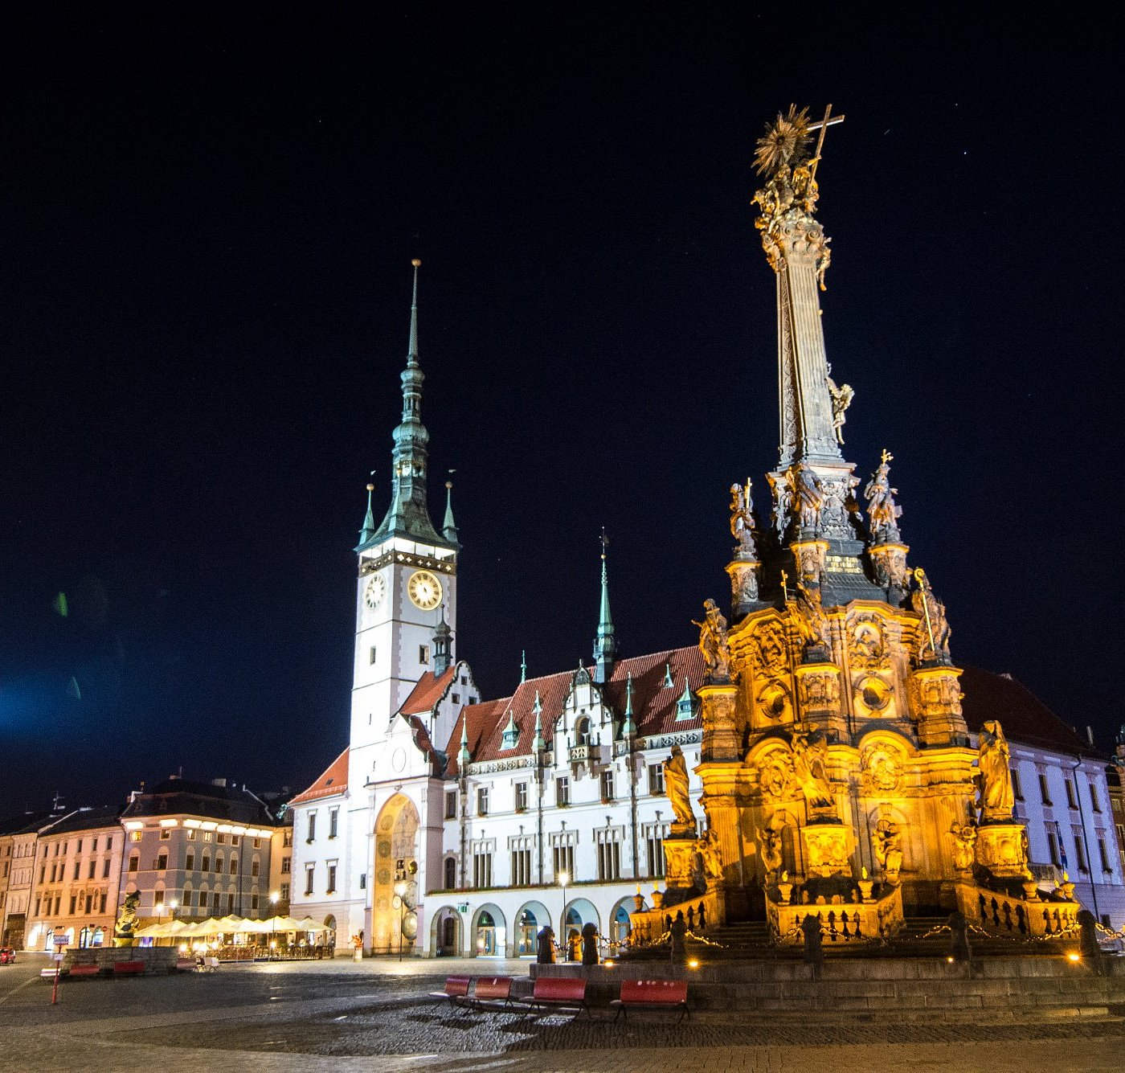
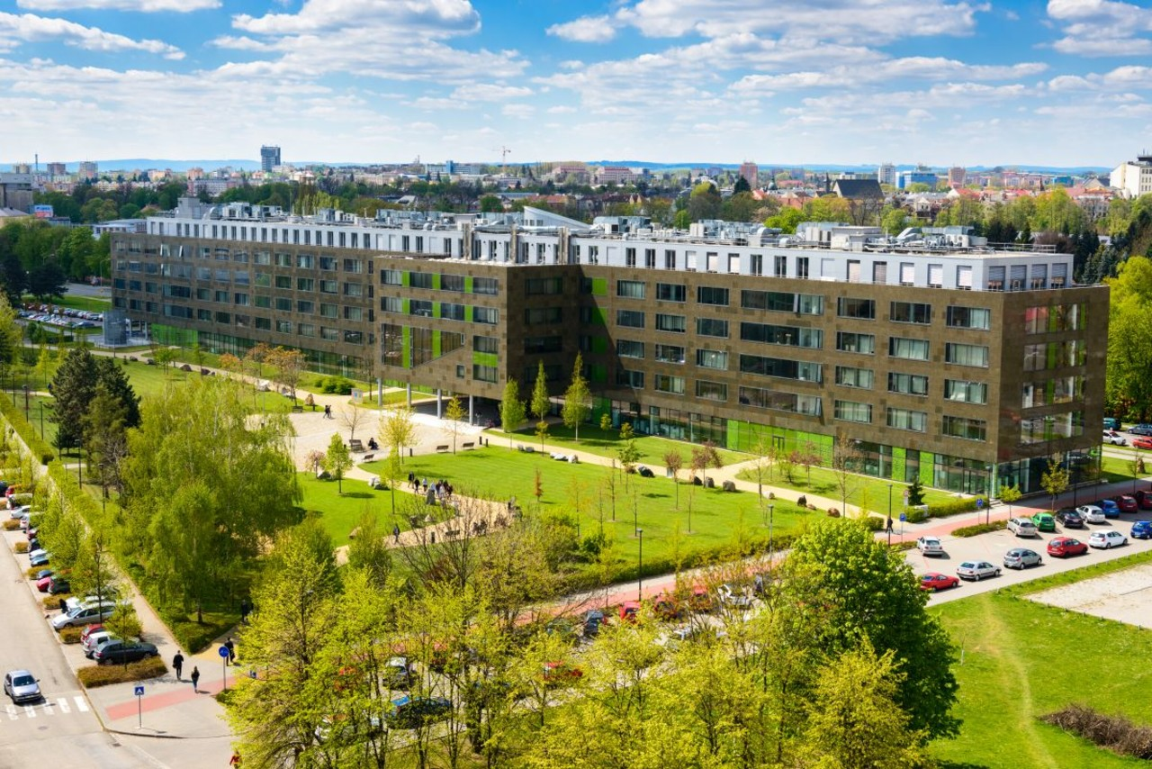

Slide 3
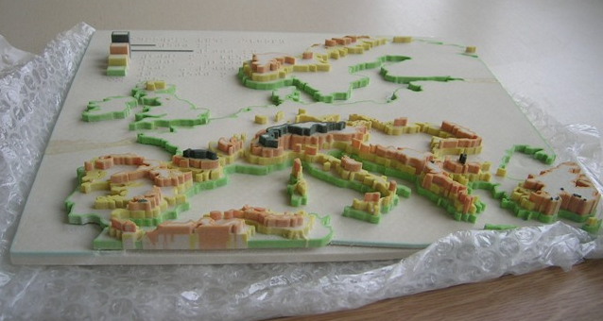
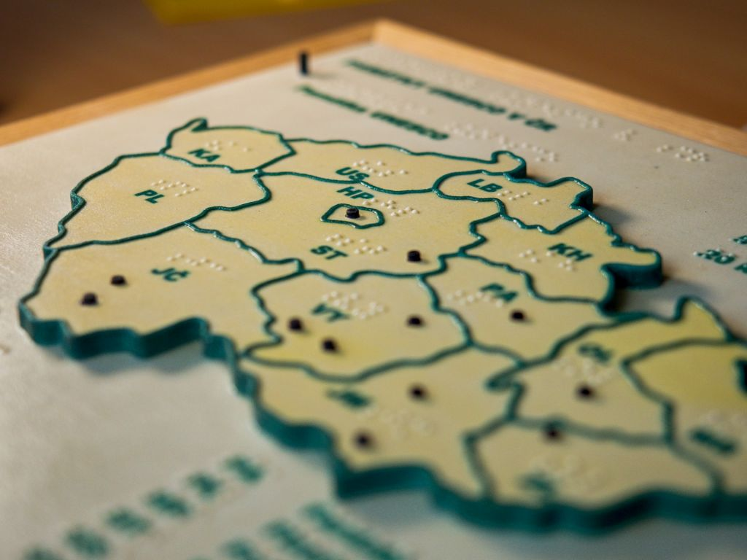
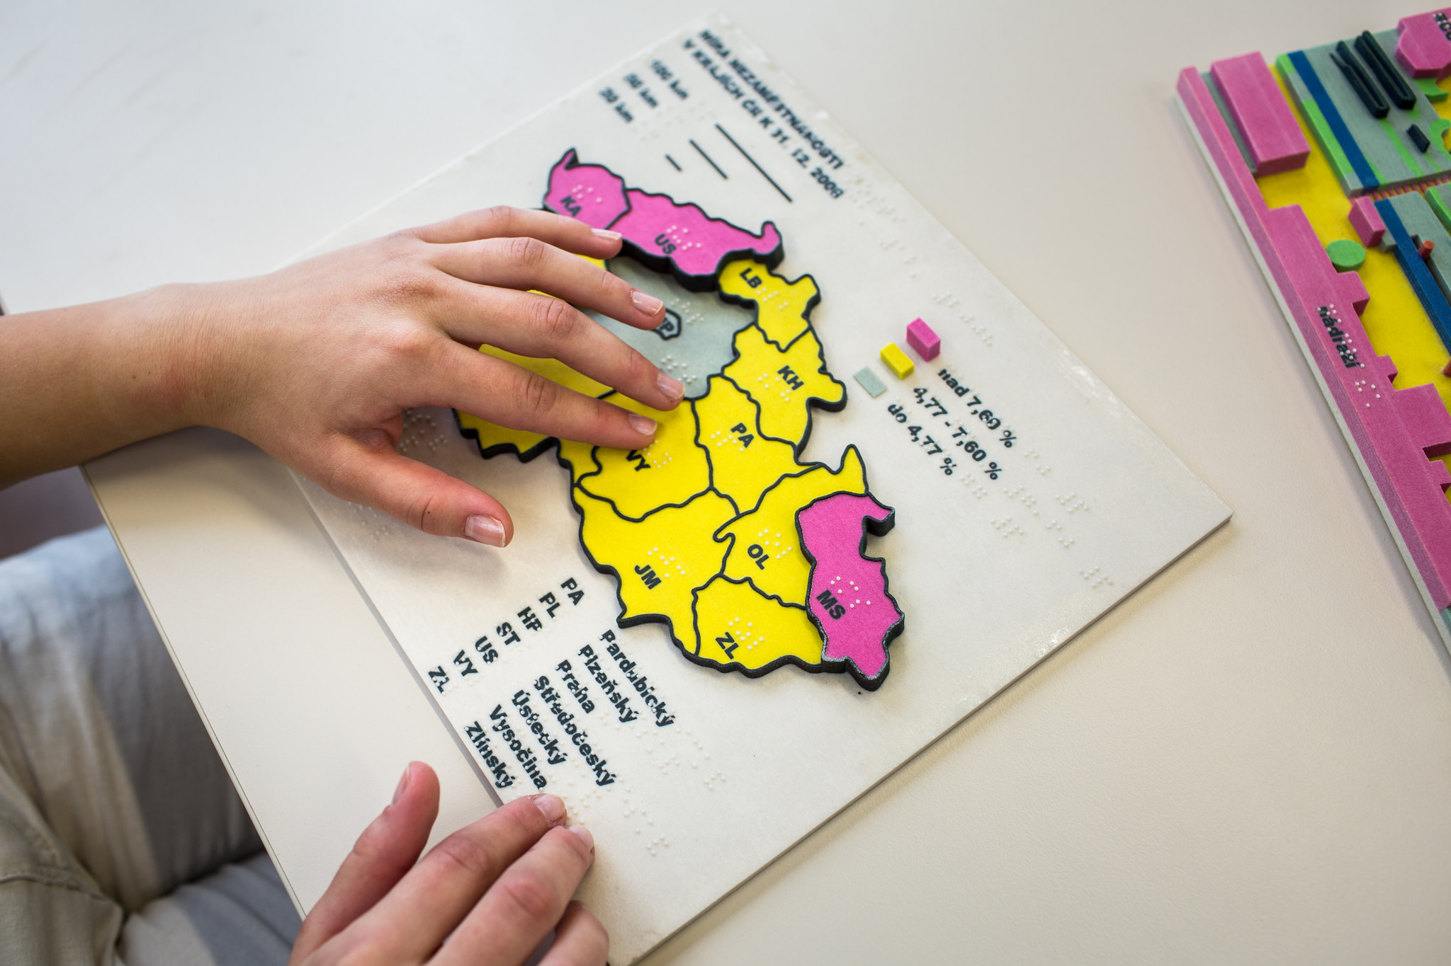
Background (2008–2010)
Technologia opracowania tyflomap zabytkowych założeń parkowych | 23 May | Warsaw
long-term research on tactile maps since 2008
designing interactive maps for people with severe visual impairment
exploring low-cost solutions

Slide 4
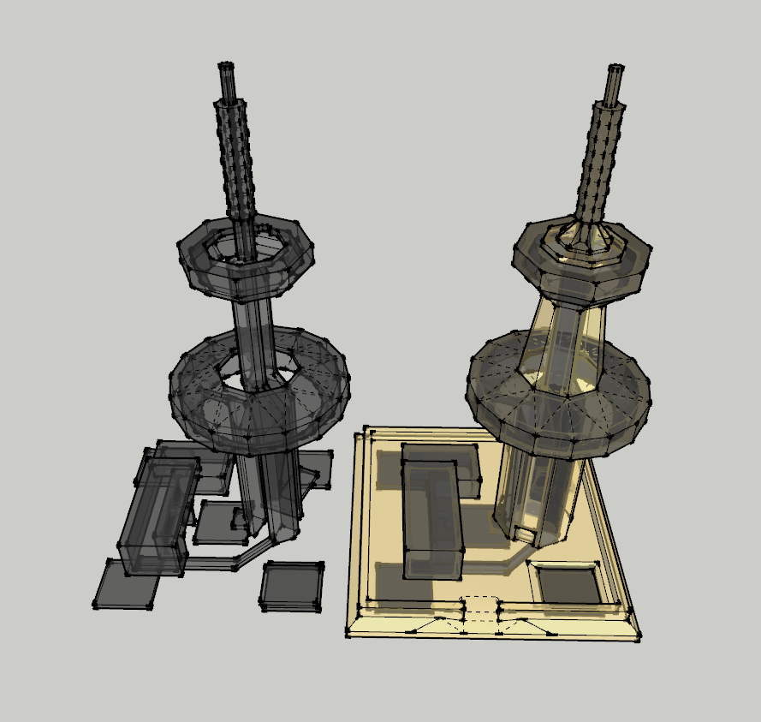
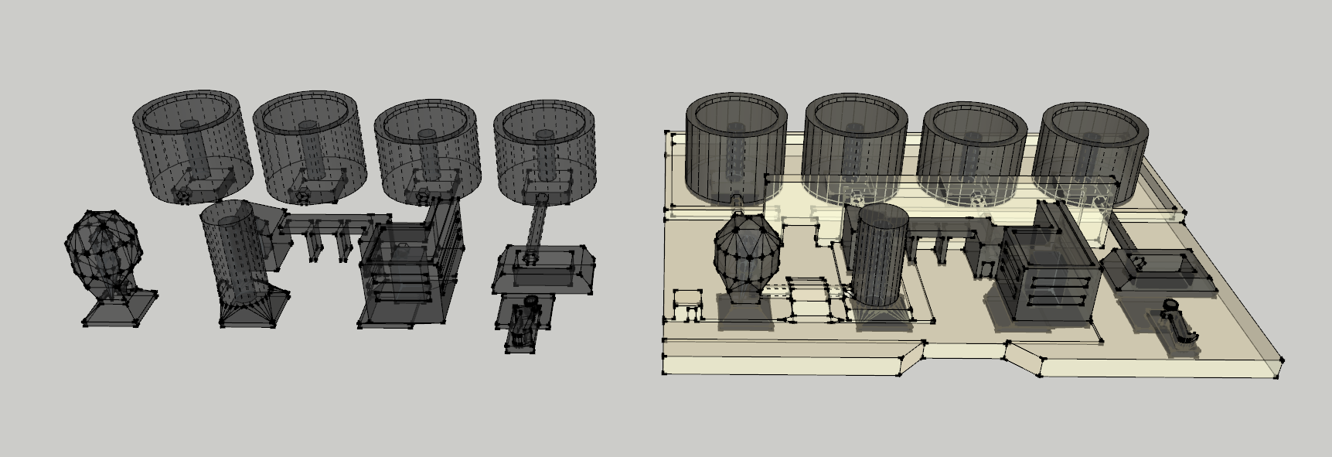
Early development (2015–2016)
Technologia opracowania tyflomap zabytkowych założeń parkowych | 23 May | Warsaw
coming with technology TouchIt3D
linking mobile devices with 3D-printed models
testing functionality and its limits

Slide 5
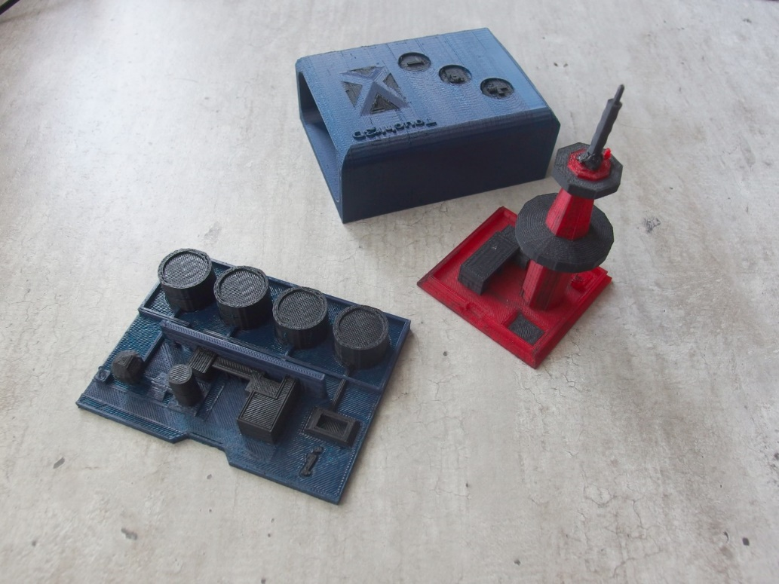
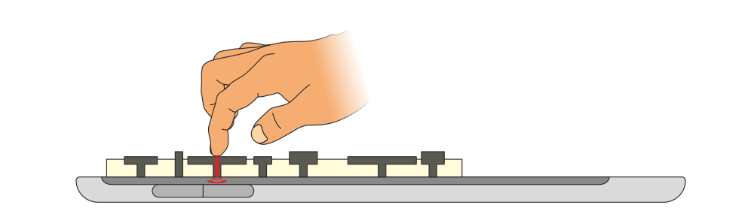
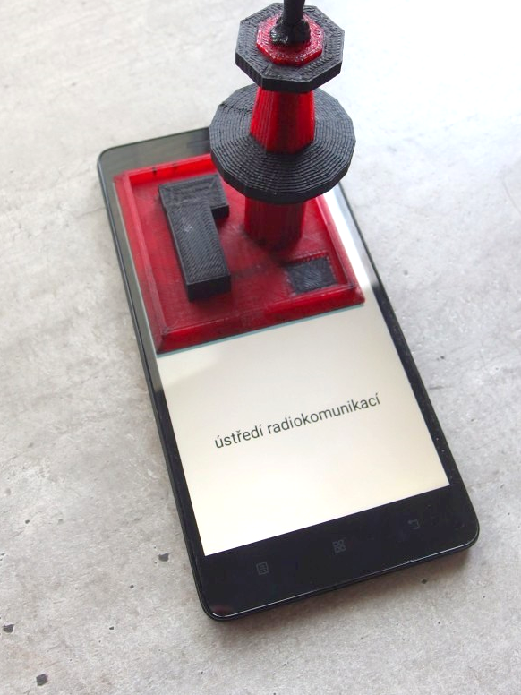
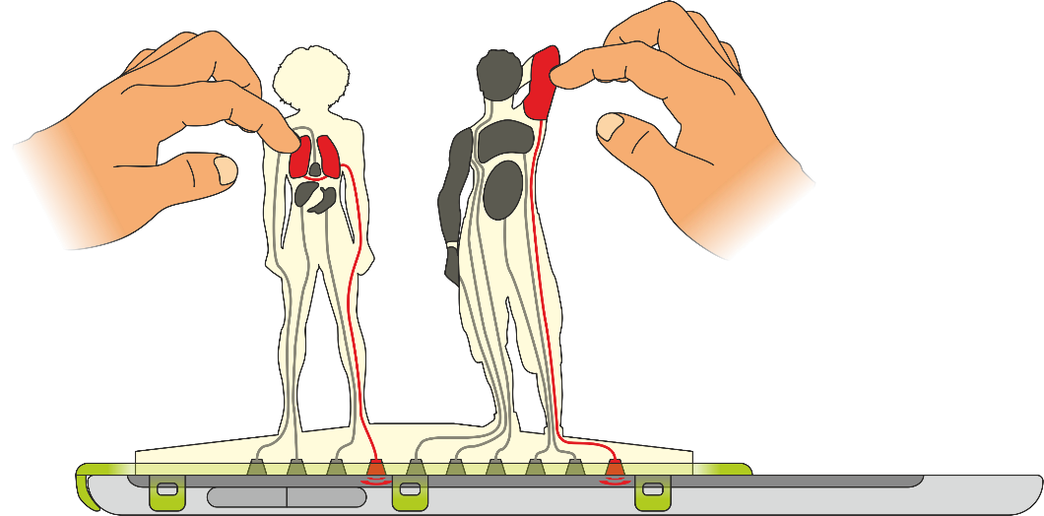
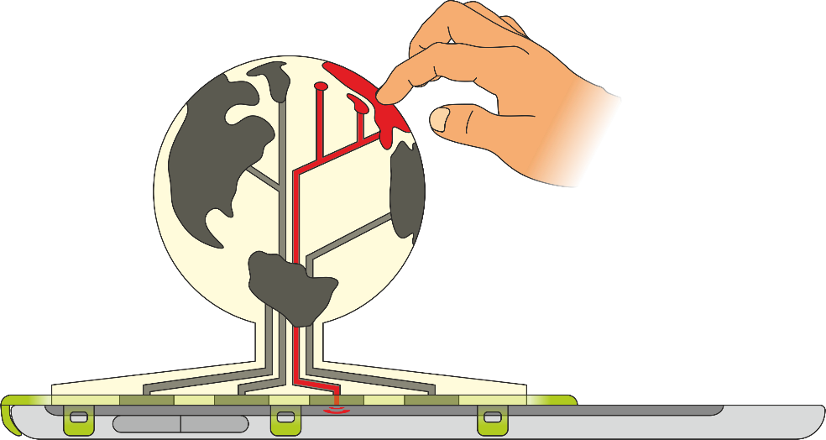
Early development
Technologia opracowania tyflomap zabytkowych założeń parkowych | 23 May | Warsaw
3D-printed plastic
models with
conductive
elements

Slide 6
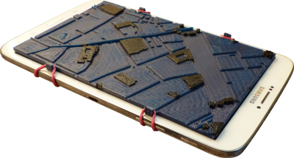
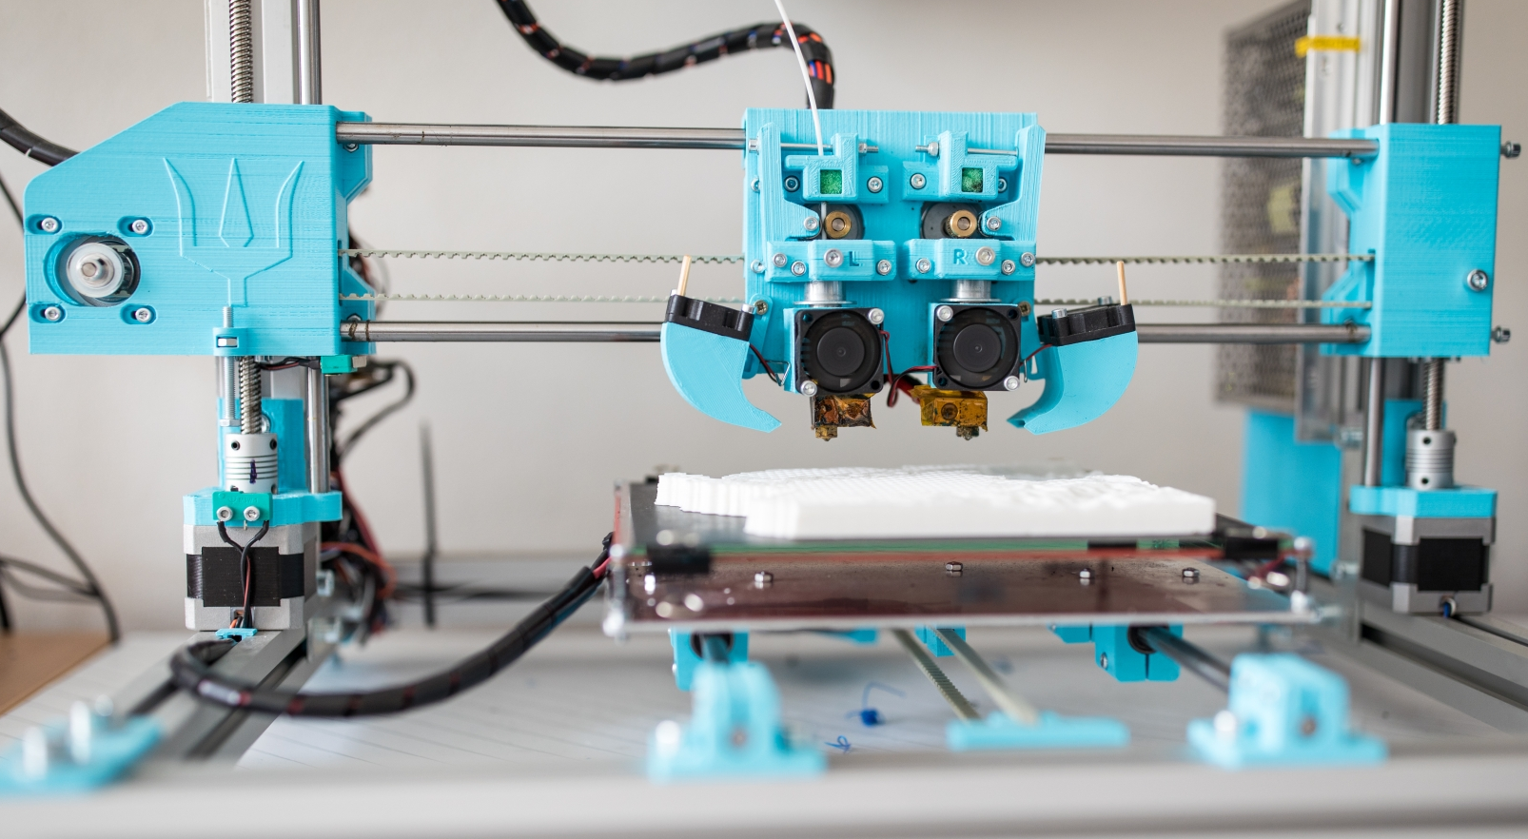
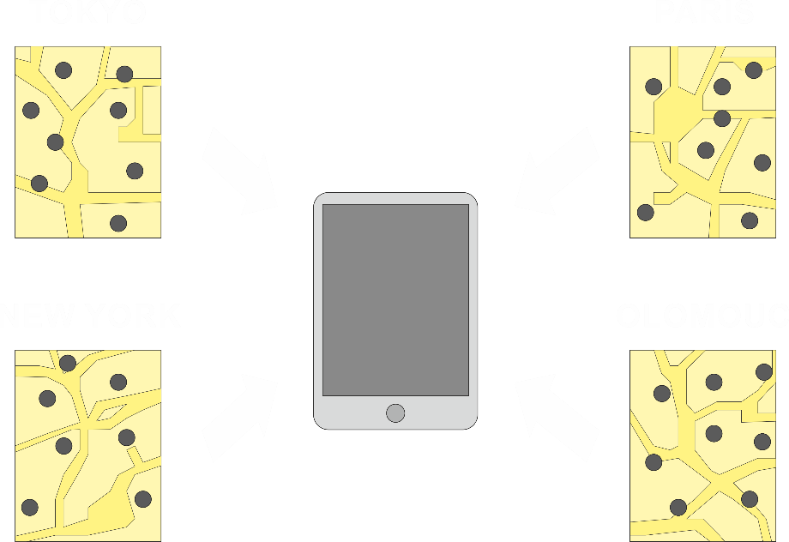
Efficient tactile maps
Technologia opracowania tyflomap zabytkowych założeń parkowych | 23 May | Warsaw
applying TouchIt3D to tactile maps
enriching interactivity, auditive description
low-cost way of interactive tactile map production

Slide 7
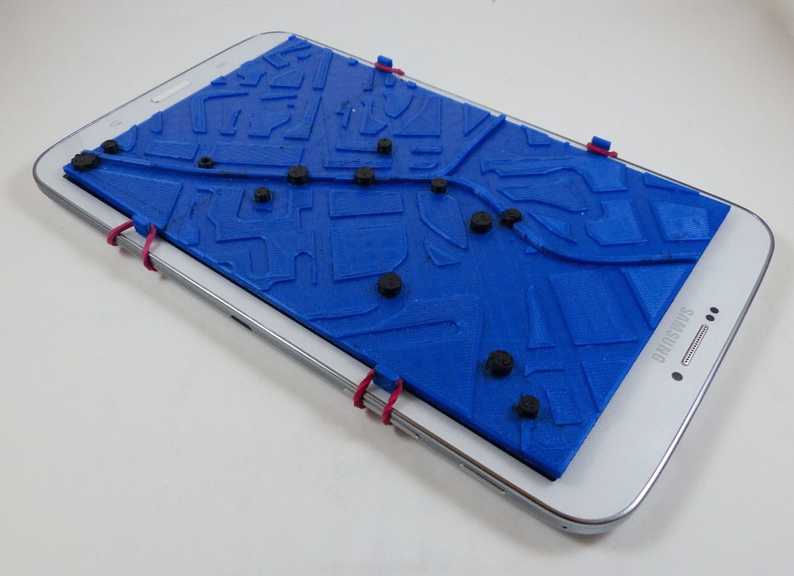
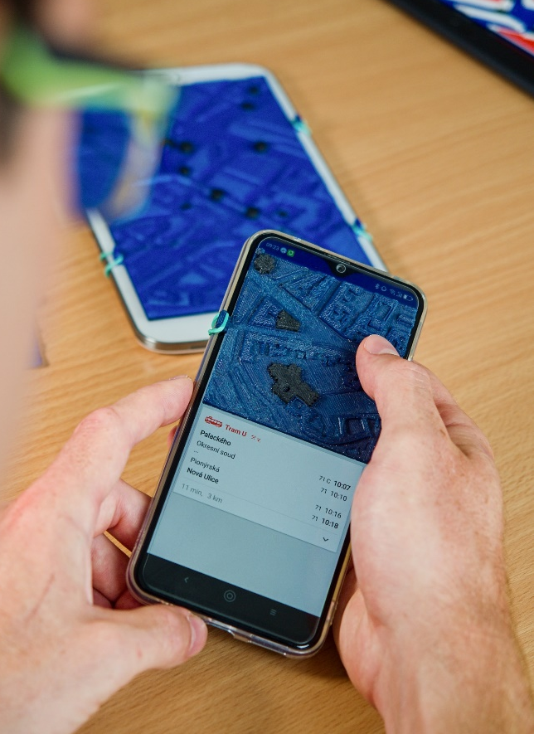
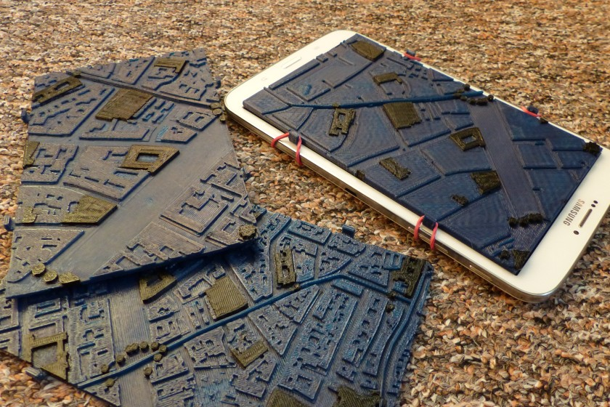
Efficient tactile maps
Technologia opracowania tyflomap zabytkowych założeń parkowych | 23 May | Warsaw
linkable with …
  smartphones
  tablets
using simple
mobile app

Slide 8
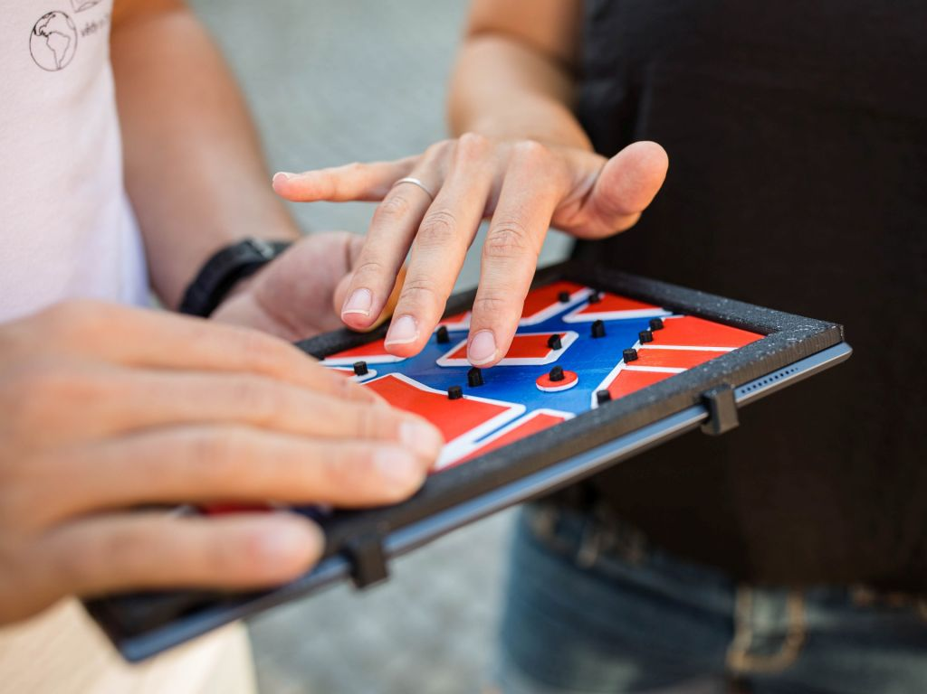
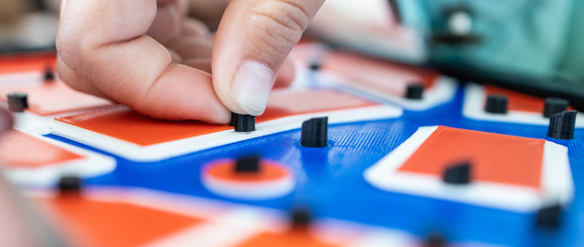
Improving map functionality (2018–2020)
Technologia opracowania tyflomap zabytkowych założeń parkowych | 23 May | Warsaw
adding colours to enhance layer distinguishness
different modes for auditive description
  short & long description
  giving task and respective feedback
  path descriptions between 2 locations

Slide 9
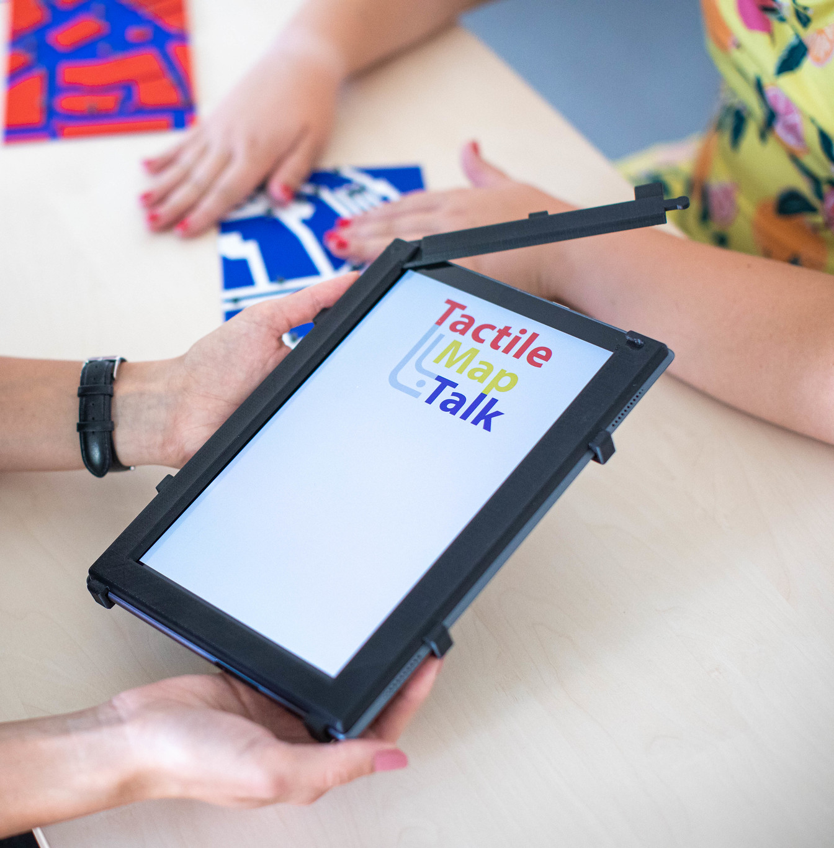
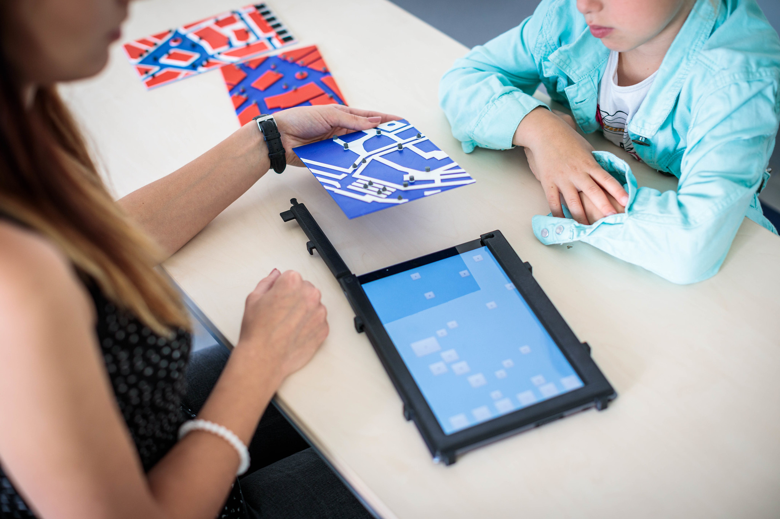
SOFTWARE BACKGROUND
Technologia opracowania tyflomap zabytkowych założeń parkowych | 23 May | Warsaw
TactileMapTalk mobile application

Slide 10
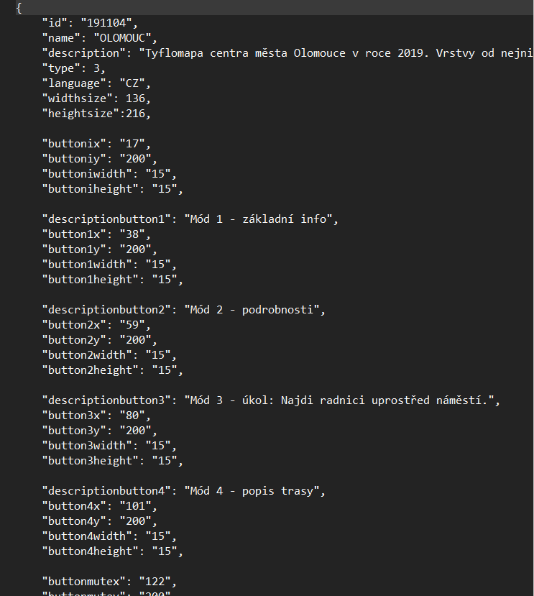
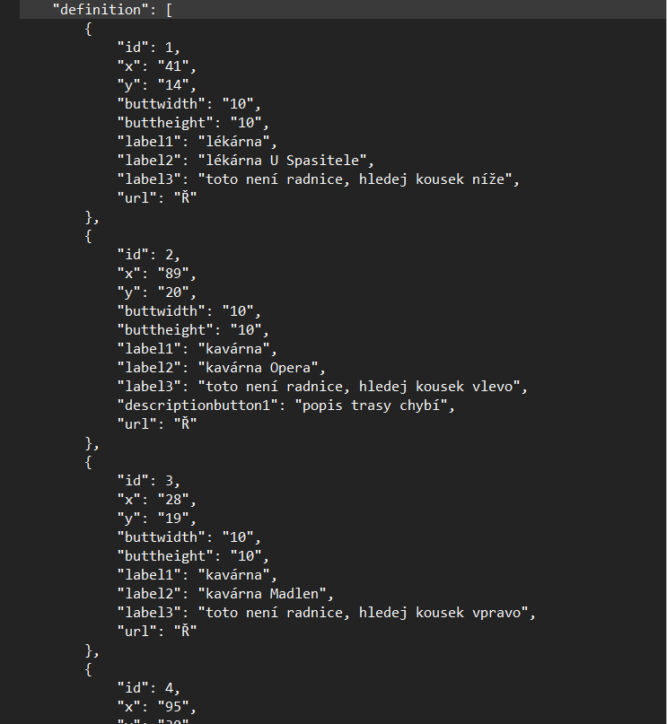

Slide 11
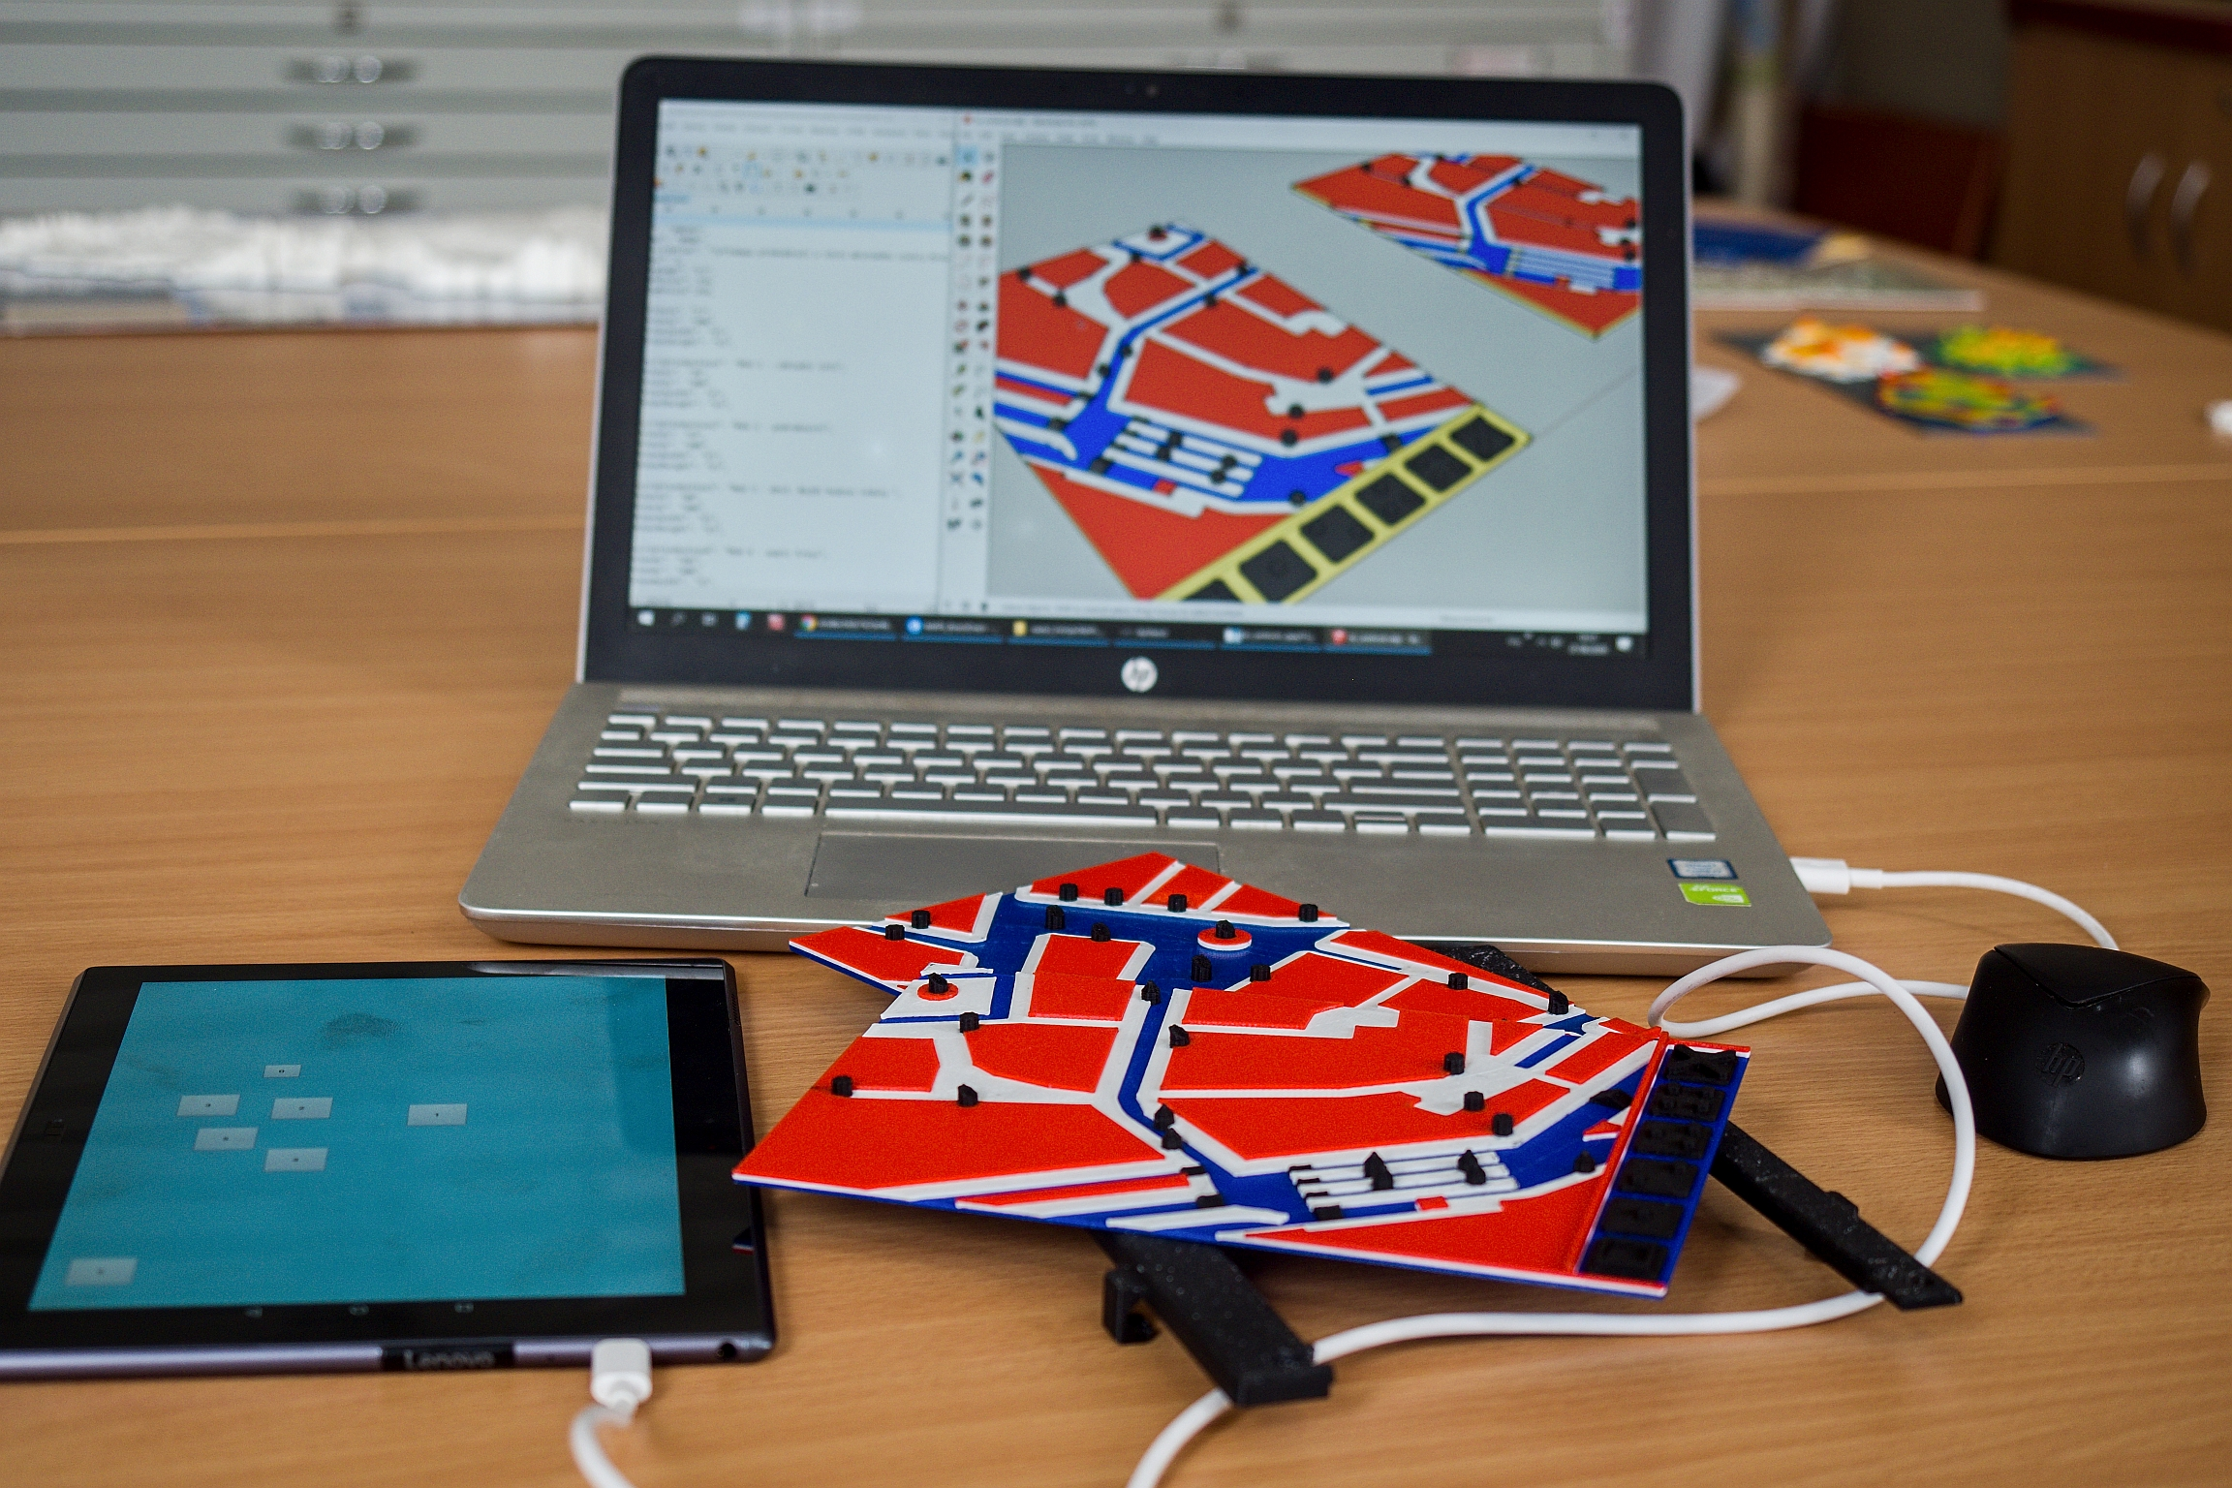
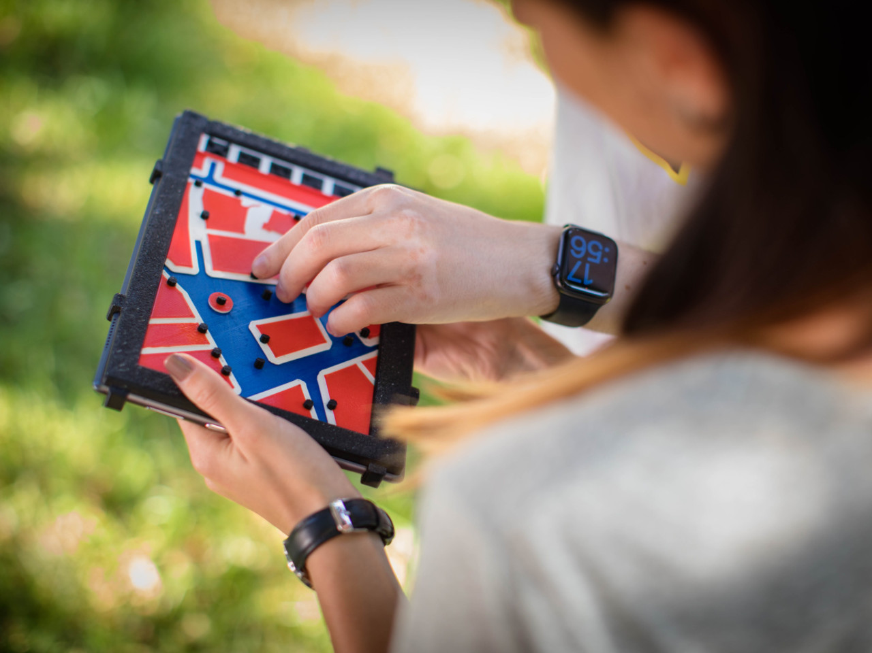
USER EVALUATION & TESTING
Technologia opracowania tyflomap zabytkowych założeń parkowych | 23 May | Warsaw
better colour contrast
improving distinguisha-
bility of map symbols

Slide 12
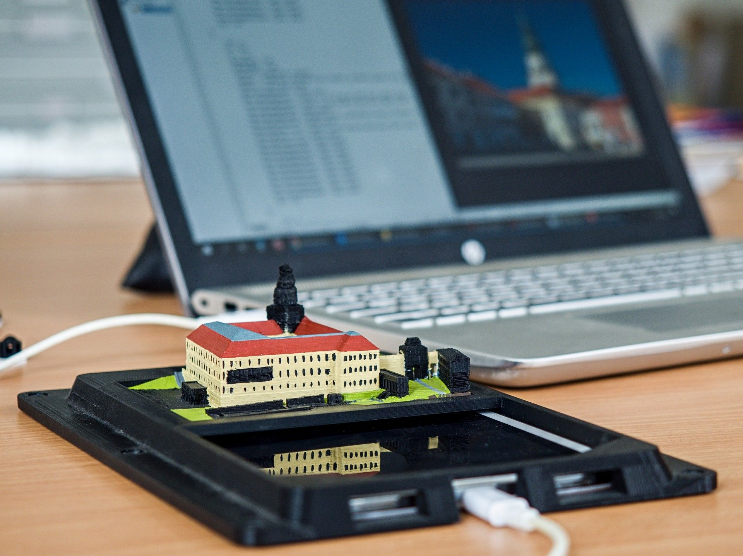
FROM MAPS BACK TO 3D MODELS (2020–2023)
Technologia opracowania tyflomap zabytkowych założeń parkowych | 23 May | Warsaw
modelling architectural
landmarks for people with
severe visual impairment
one landmark for each
of 14 regions in Czechia
  castles & palaces
  churches & cathedrals
  historical buildings
  rural architecture
  modern buildings

Slide 13
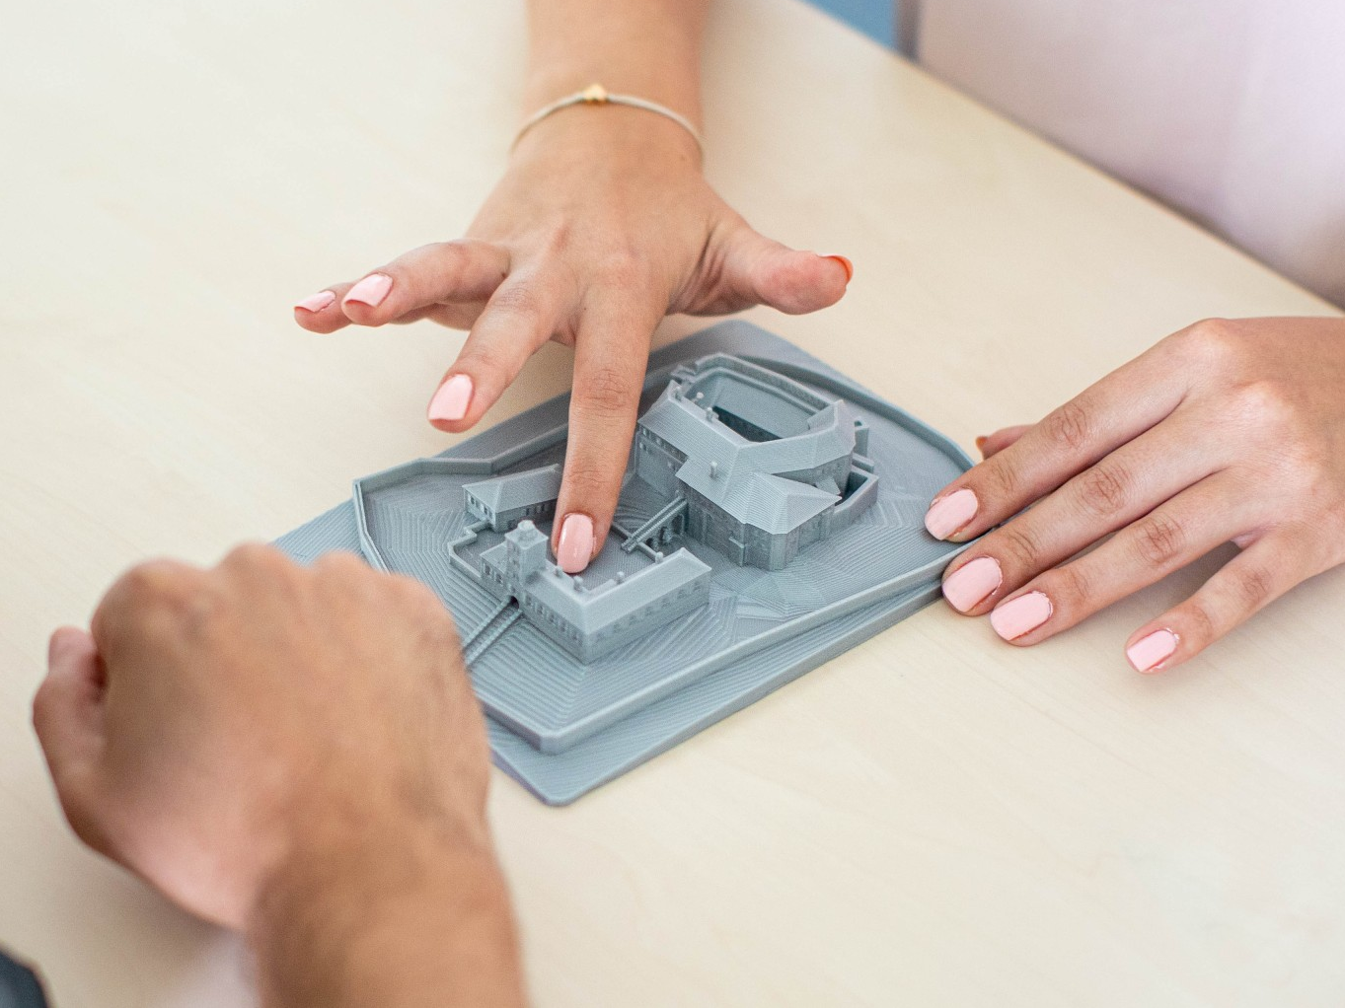
FROM TACTILE MAPS BACK TO 3D MODELS
Technologia opracowania tyflomap zabytkowych założeń parkowych | 23 May | Warsaw
aiming to present …
  differences in size/dimensions
  structure of buildings
  architectonic styles
  interesting historical facts
  compatible with education
supplemented with excursions
  using the models in the field
  mixing the imagination of
  real world & tangible model

Slide 14
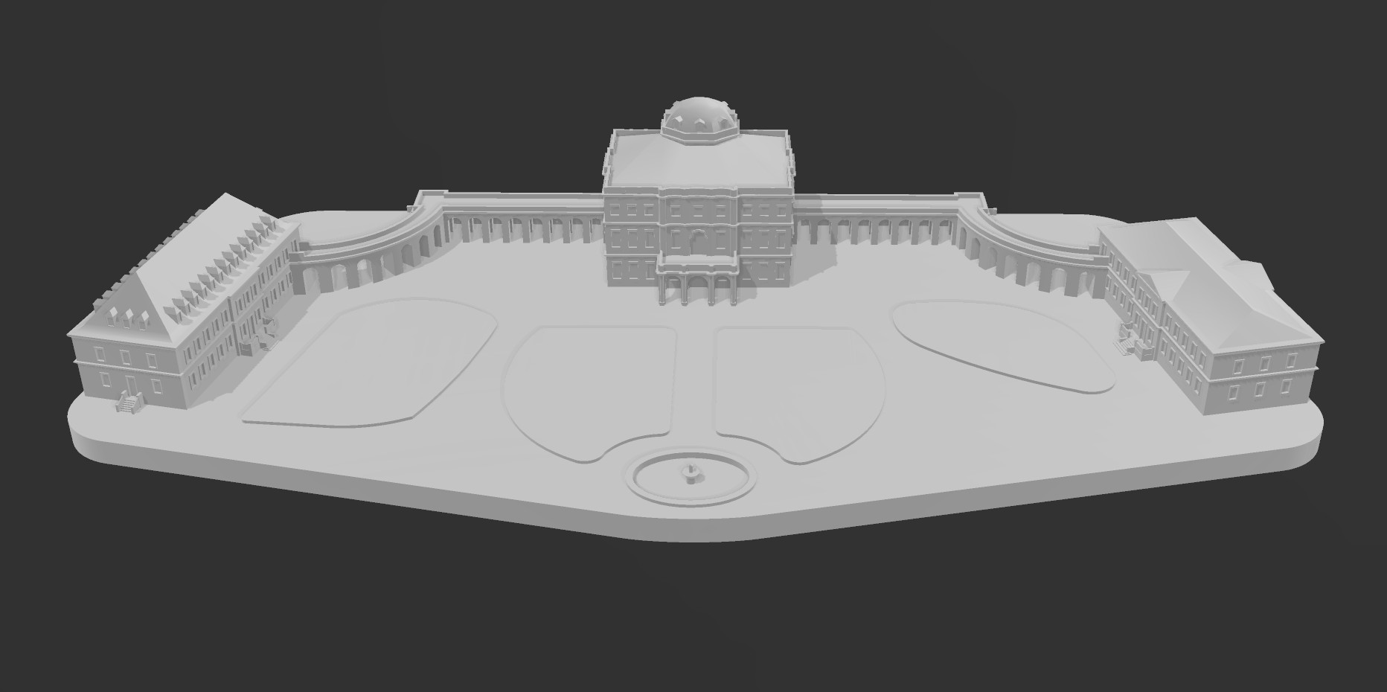
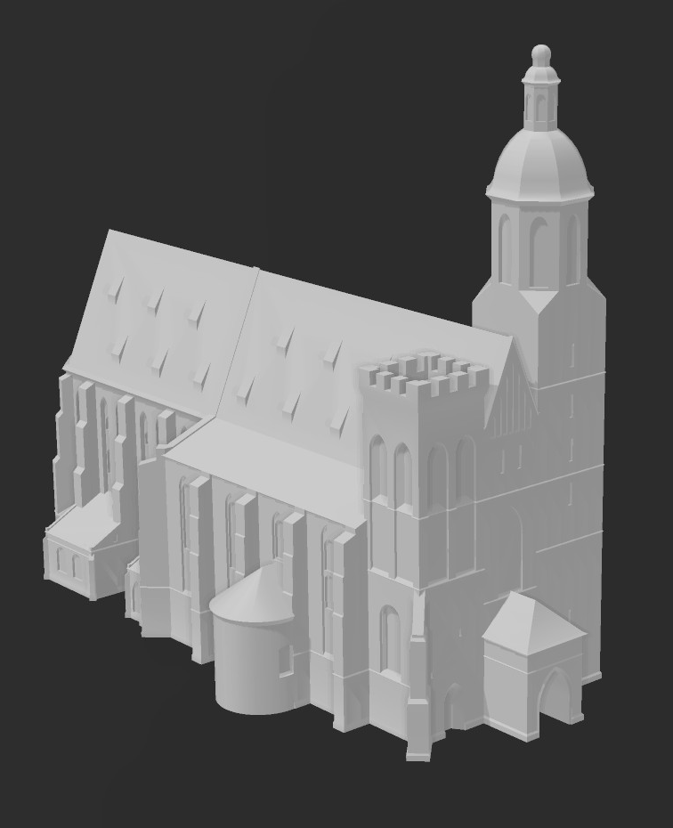
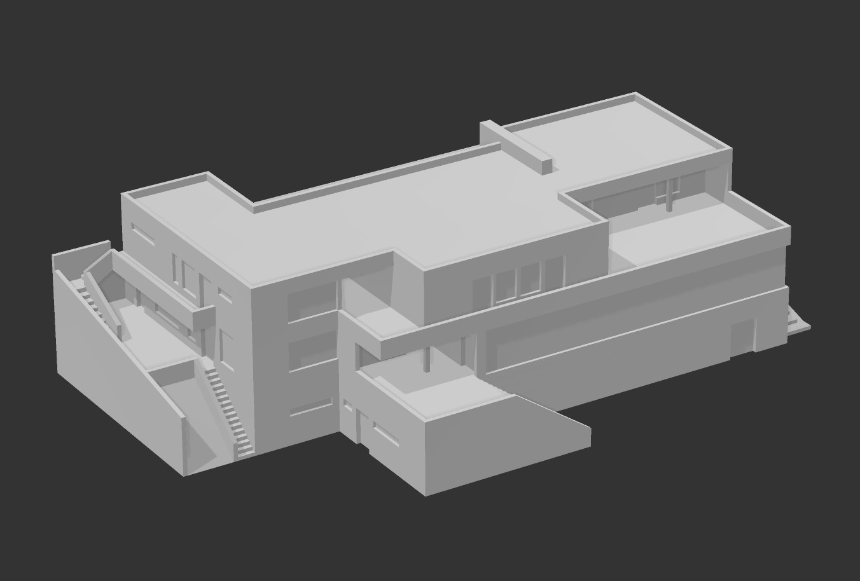
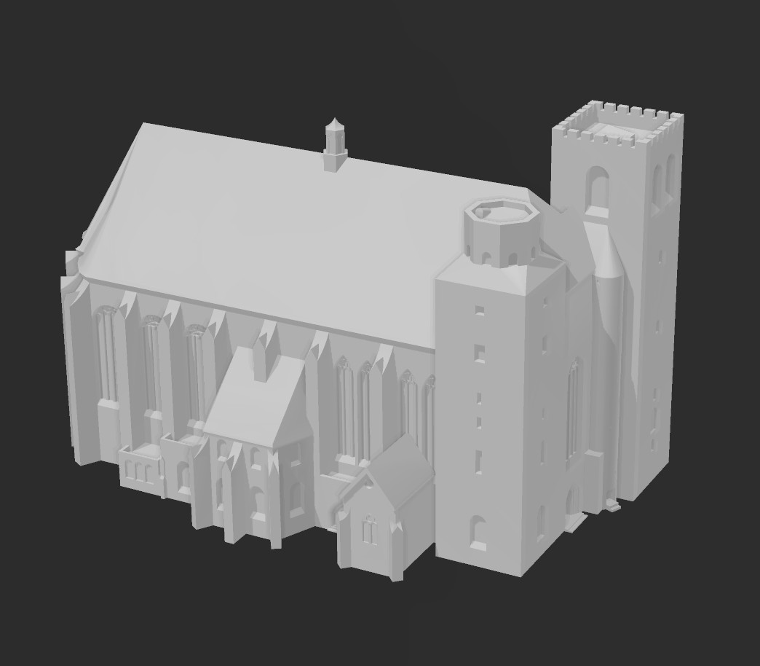
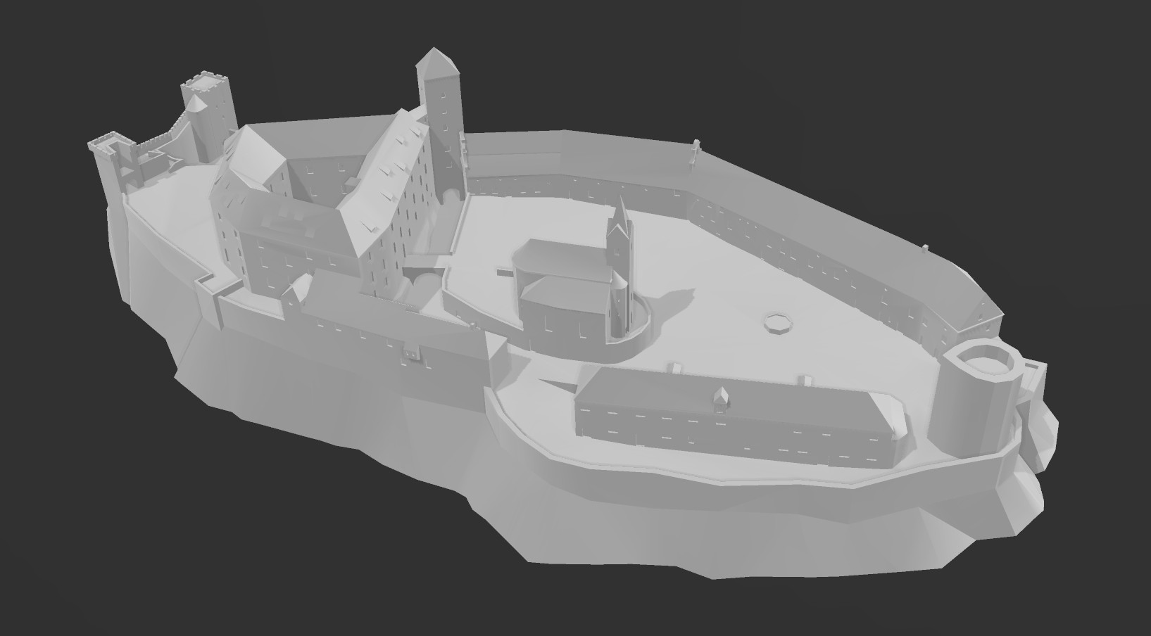
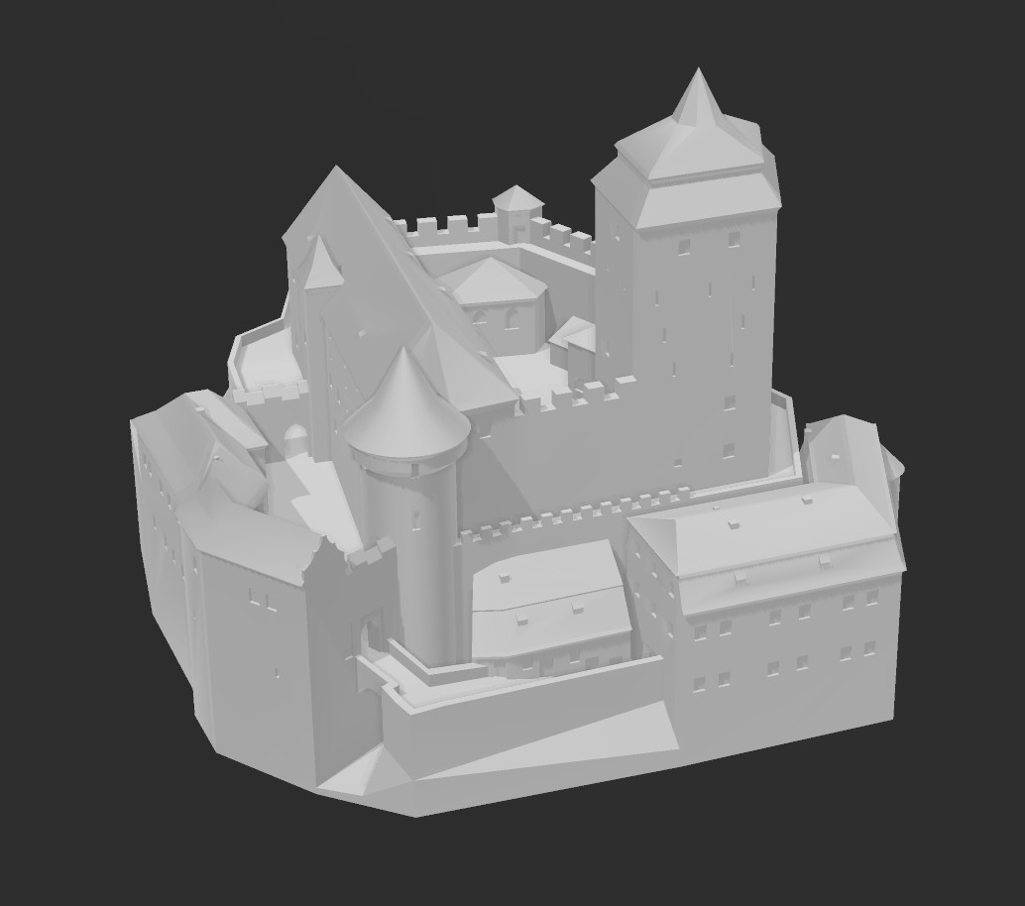
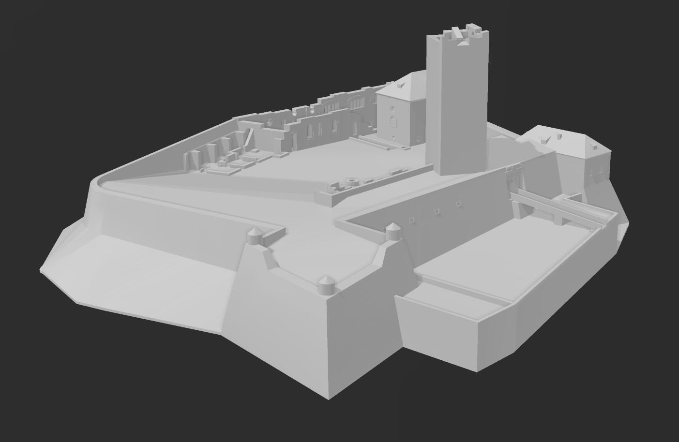
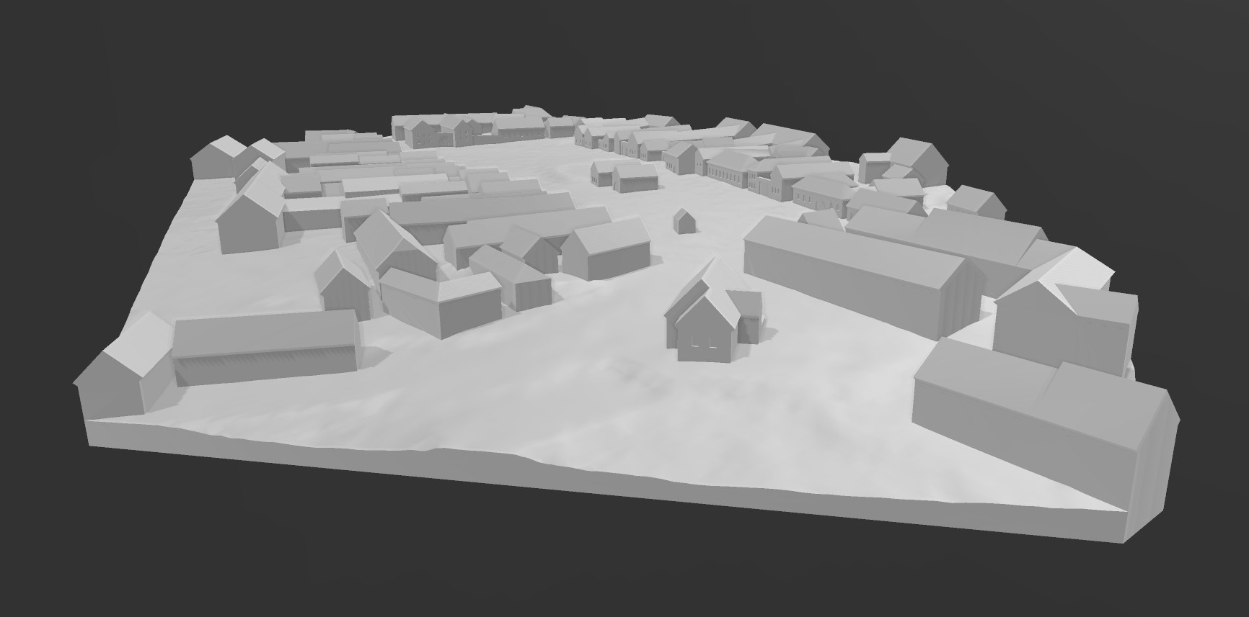
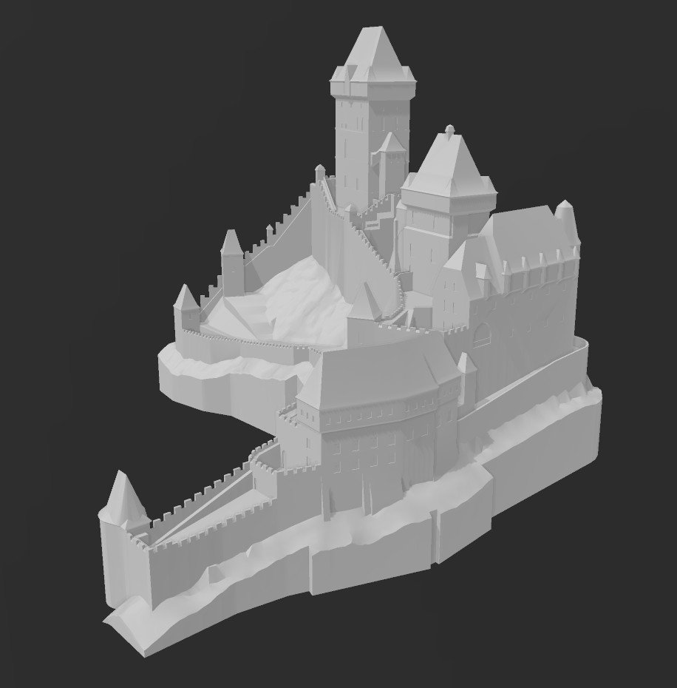
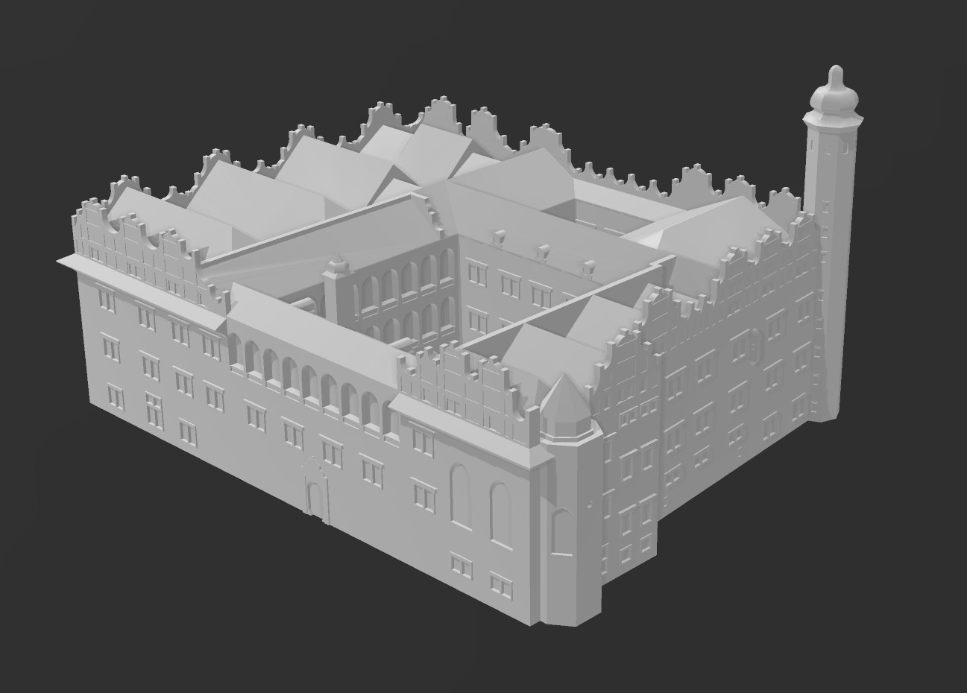
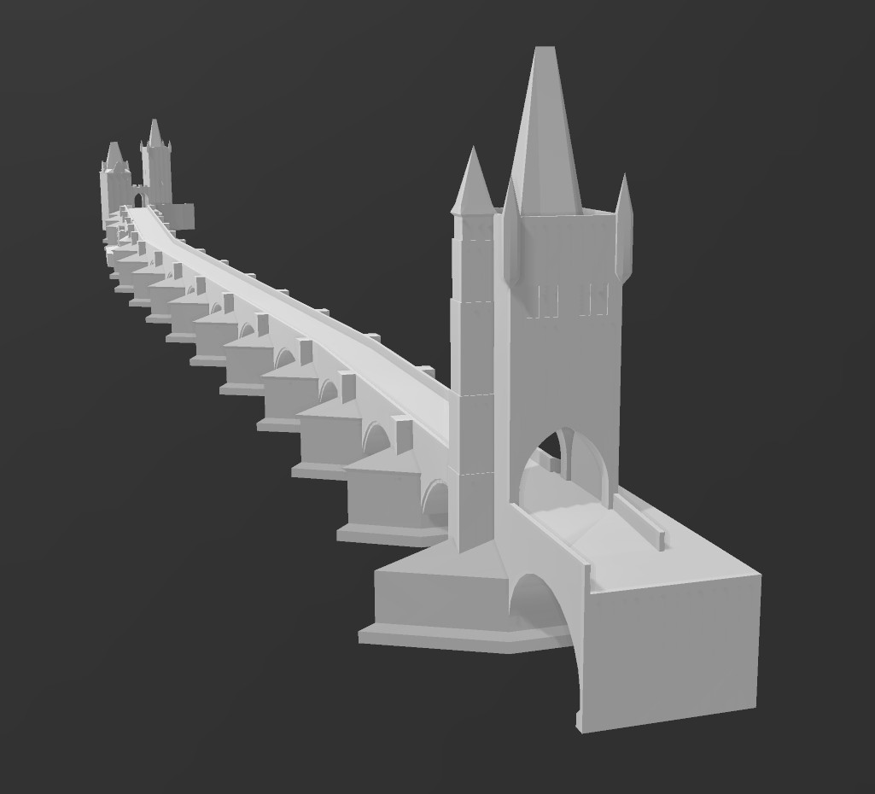
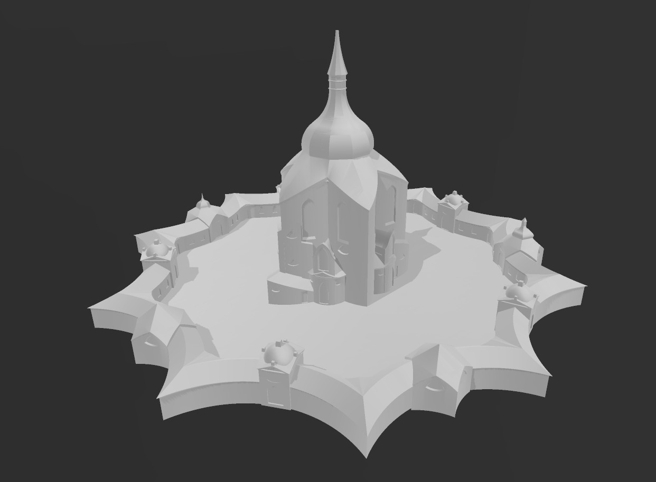
Technologia opracowania tyflomap zabytkowych założeń parkowych | 23 May | Warsaw

Slide 15
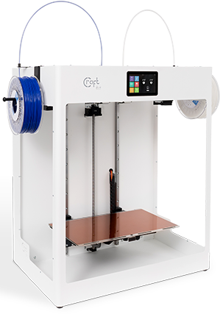
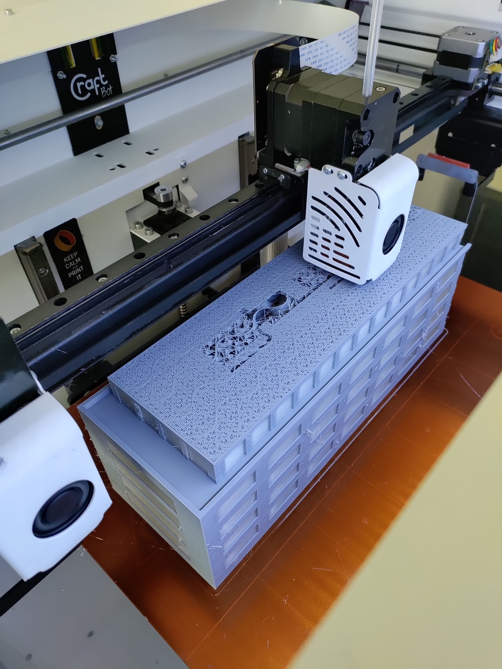
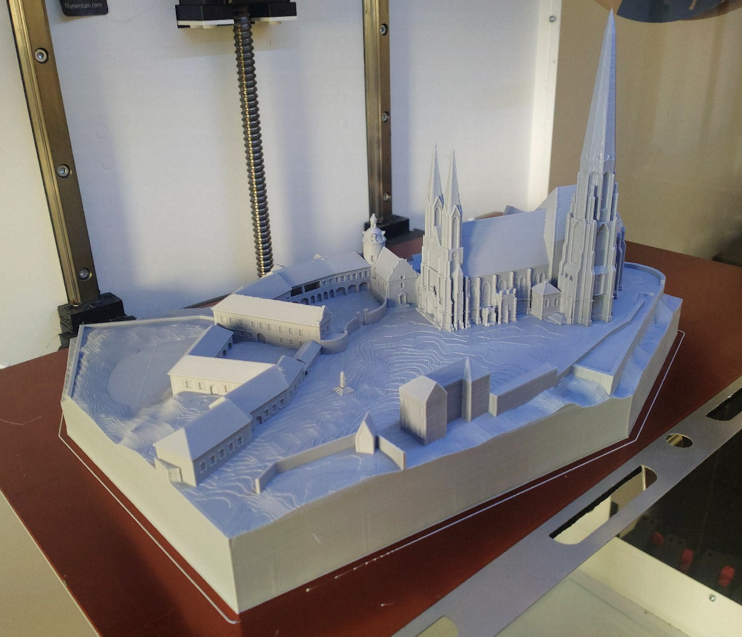
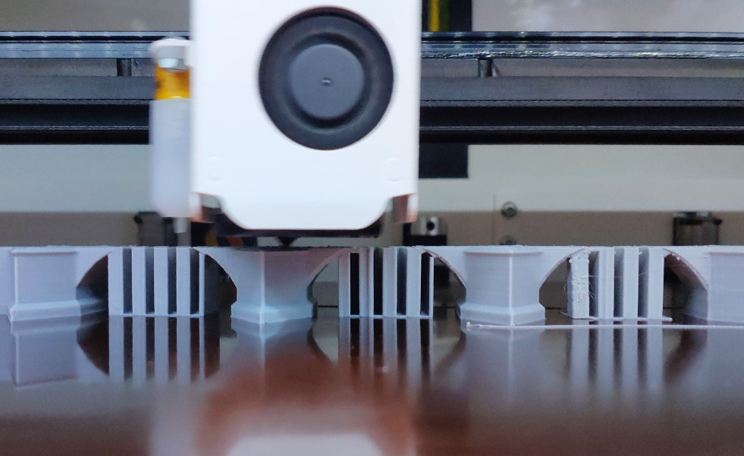
making models large
Technologia opracowania tyflomap zabytkowych założeń parkowych | 23 May | Warsaw
Craftbot FLOW XL
  300 × 200 × 500 mm
  building volume
  dual extrusion

Slide 16
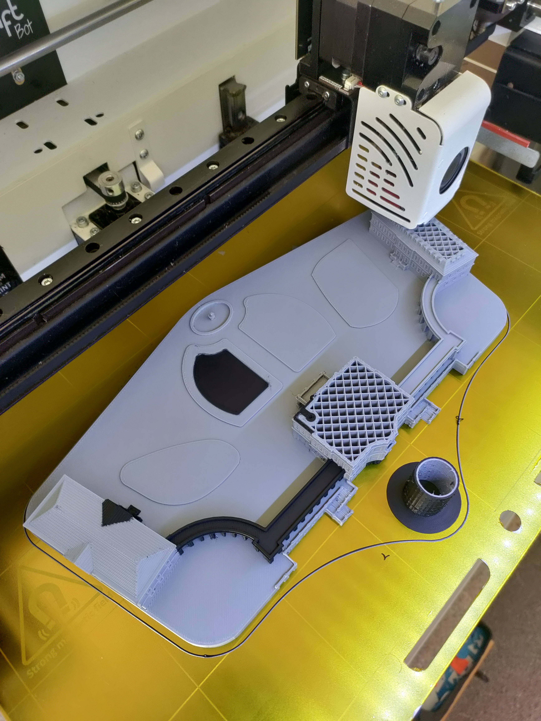

NEED of software modification
Technologia opracowania tyflomap zabytkowych założeń parkowych | 23 May | Warsaw
interactive elements not always recognisable
different approach for auditive description

Slide 17
BEFORE (for tactile maps)
TouchIt 2023 | 11 Technologia opracowania tyflomap zabytkowych założeń parkowych | 23 May | Warsaw
no interaction immediately
after 1 second holding
  vibrations
  auditive description
  of respective feature

Slide 18
NOW (FOR 3D MODELS)
Technologia opracowania tyflomap zabytkowych założeń parkowych | 23 May | Warsaw
immediately and during
all time of a contact
  vibrations
after 3 seconds holding
  auditive description of
  respective feature

Slide 19
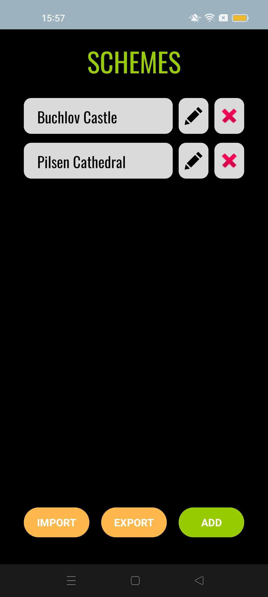
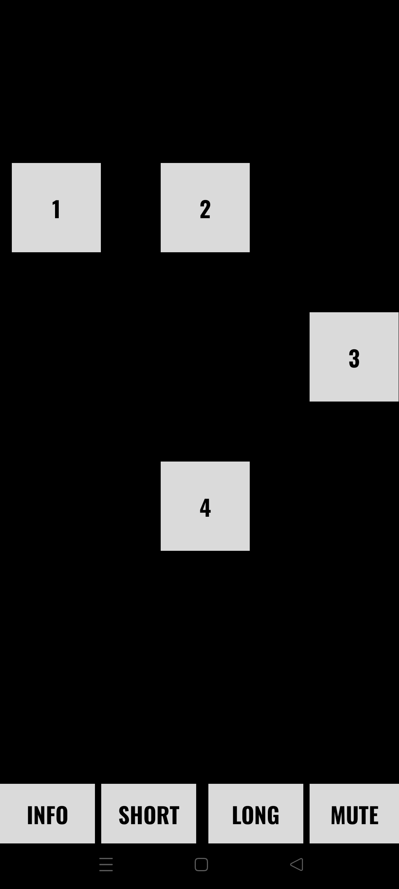
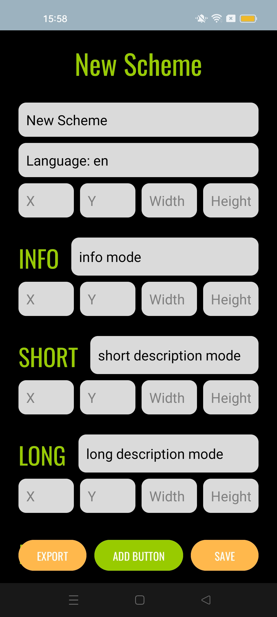
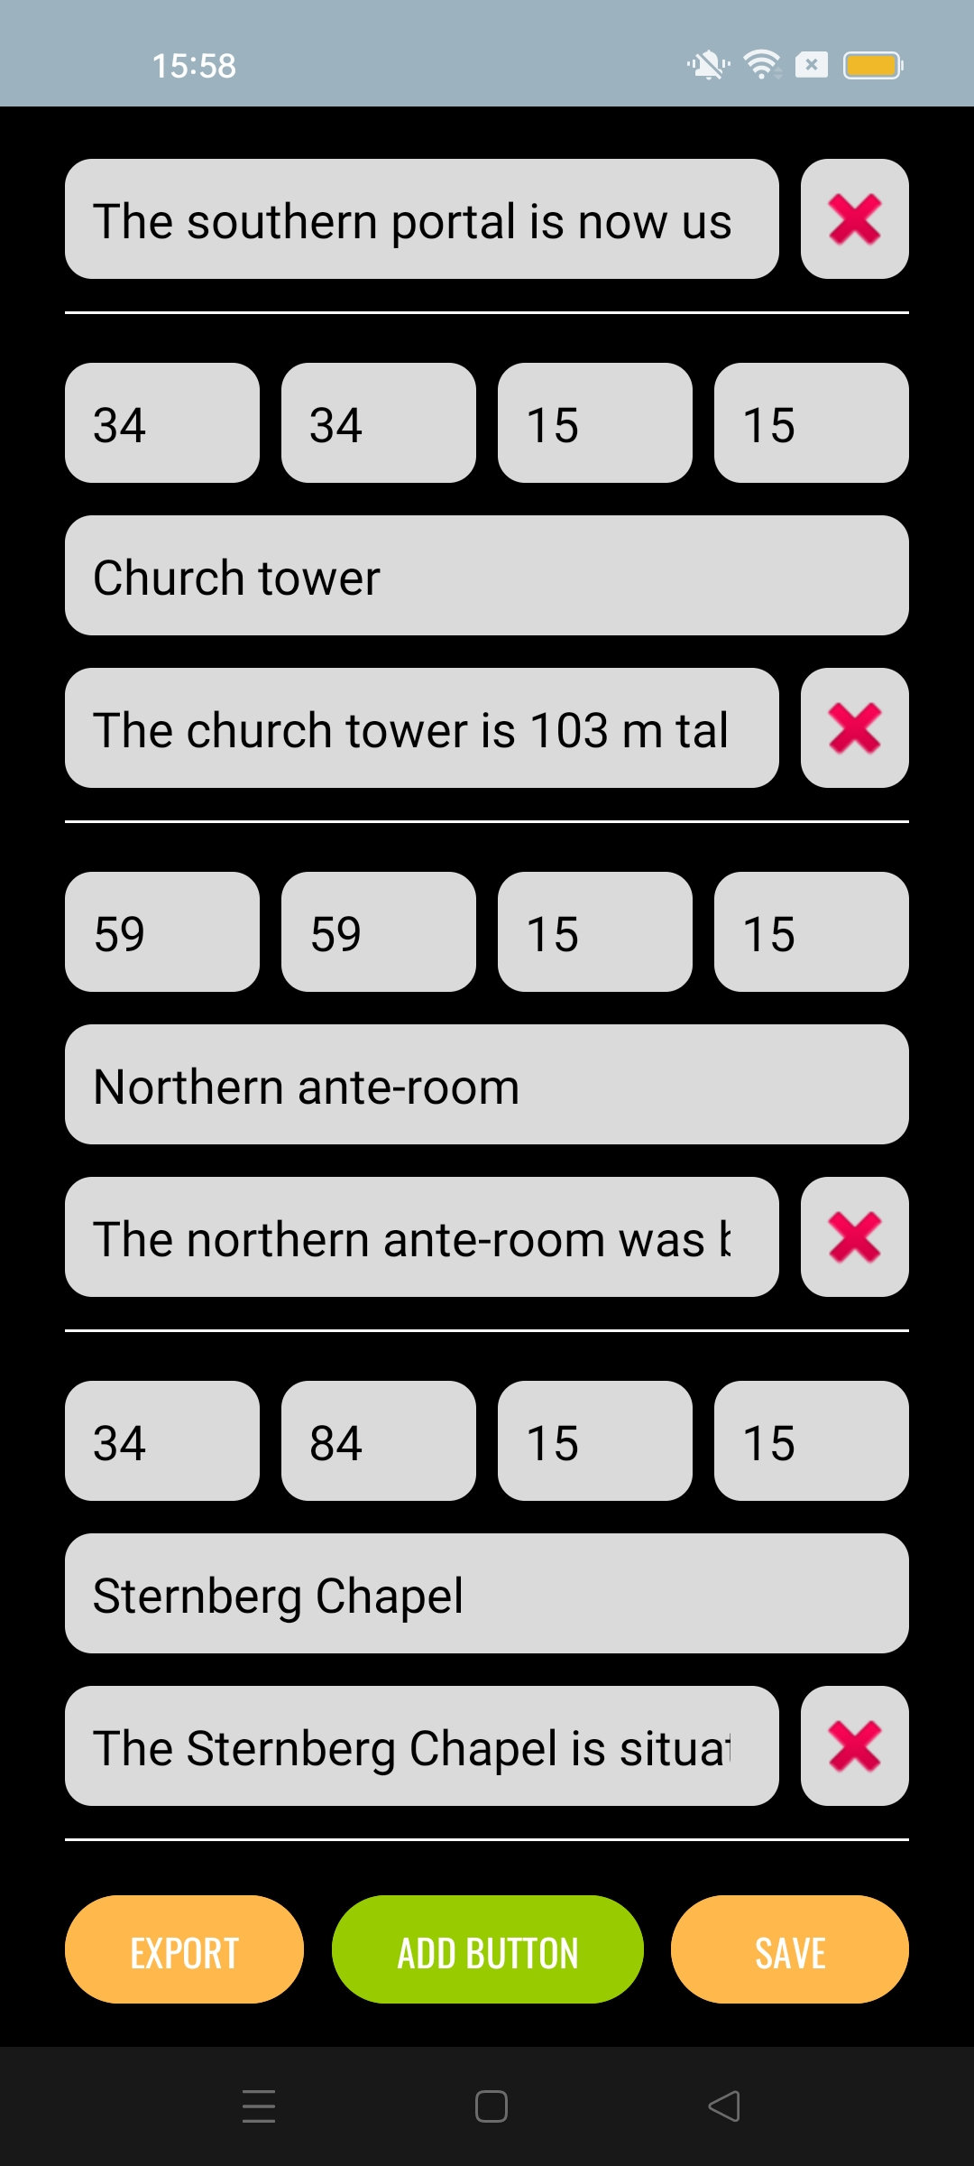
Technologia opracowania tyflomap zabytkowych założeń parkowych | 23 May | Warsaw
NEW FUNCTIONALITY
main menu with
the list of schemes
active mode
for each scheme
editing mode for designing new or editing existing schemes

Slide 20


BOOK SERIES
Technologia opracowania tyflomap zabytkowych założeń parkowych | 23 May | Warsaw
tactile maps-graphics-
-models-cartography
complex books about
tactile cartography &
TouchIt 3D technology
in Czech language
available online free
tactilemaps.upol.cz/
project-outputs

Slide 21

TouchIt 3D
INTERACTIVE TACTILE MAPS & MODELS
LINKABLE WITH MOBILE DEVICES
Radek Barvíř
✉️ radek.barvir@upol.cz
Palacký University Olomouc
🌎 tactilemaps.upol.cz
🌎 cartography.upol.cz

